Slide 1









Measuring Representational Robustness of Neural Networks Through Shared Invariances
Vedant Nanda
University of Maryland & MPI-SWS
ICML 2022
Till Speicher
Camila Kolling
Krishna P. Gummadi
John P. Dickerson
Adrian Weller

Slide 2
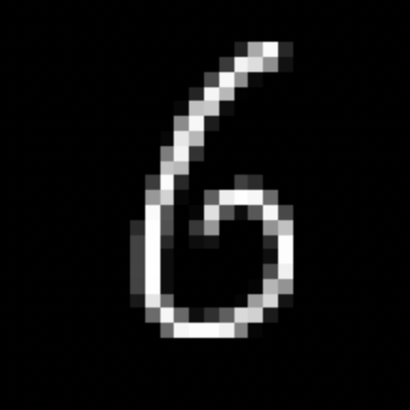
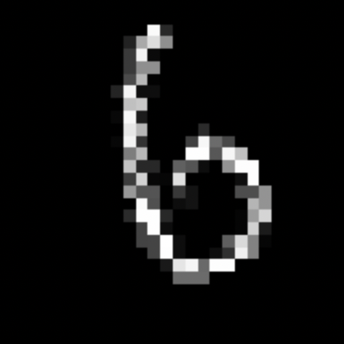



Robustness in Deep Learning
“Desired” Invariances: 𝓣 = { 𝙏_{i} | 𝒇( 𝙏_{і}(𝒙) ) = 𝒇(𝒙) }
𝒇 ( ) = 𝒇 ( )
𝒇 ( ) = 𝒇 ( )
Prior works (Szegedy et al., 2013; Recht et al., 2020):
“Desired” = set of input transformations that do not change output for a human
Robustness is inherently relative*!
* w.r.t. “human”
Notes:
Stronger motivation for invariances

Slide 3

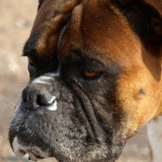
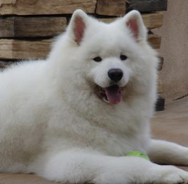
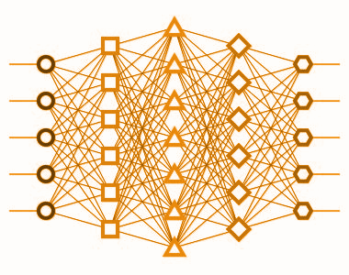
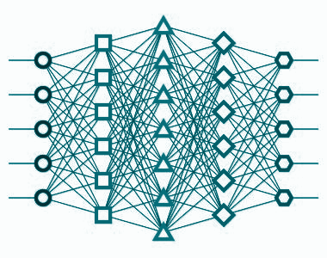

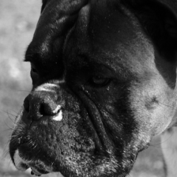
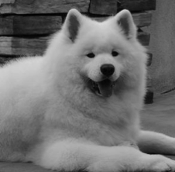
What if 𝓣 is defined by another Neural Network?
“Desired” Invariances: 𝓣 = { 𝙏_{i} | 𝒇(𝙏_{і}(𝒙)) = 𝒇(𝒙) }
“Desired” = input transformations that do not change output for a reference Network 𝒎₁
𝒎₁ (reference)
𝒎₂
𝙓
same
same ?
𝙏(𝙓)
Robustness evaluation = measuring shared invariances between 𝒎₁ & 𝒎₂
A more granular view on robustness – depends on reference model 𝒎₁
Notes:
Invarianece where? Output or representation?

Slide 4

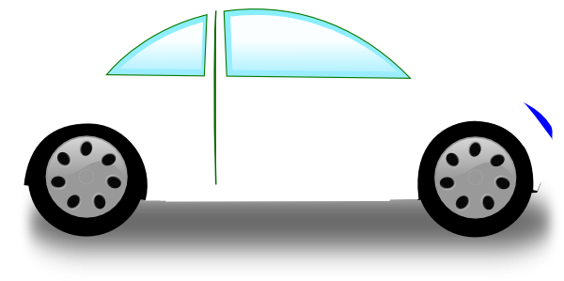
Why define 𝓣 using another Neural Network?
Instead of having to rely on approximations of human perception (e.g., class labels), we have full access to representations of reference neural network
Allows us to investigate interesting questions about Deep Learning
Architectures & Losses
Weight Initialization
Shared Invariance
Training Dataset
Model Updates
Useful for a future society with multiple agents (e.g., driverless cars) controlled by neural nets
Notes:
This generalizes the implicit assumption that set of transformations a NN should be robust to are defined wrt another system (human)

Slide 5
Problem statement
Given a Neural Network 𝒎₂ : ℝ^{m} → ℝ^{d2} ,
Reference Network 𝒎₁ : ℝ^{m} → ℝ^{d1} ,
Inputs (𝙓 ∈ ℝ^{n x m} ),
How to measure shared invariances of 𝒎₂ w.r.t. 𝒎₁ given some 𝙓, i.e.,
0 ≤ S_{inv}( 𝒎₂ | 𝒎₁, 𝙓 ) ≤ 1
Such a measure S_{inv} would be directional by design
S_{inv}( 𝒎₂ | 𝒎₁, 𝙓 ) ≠ S_{inv}( 𝒎₁ | 𝒎₂, 𝙓 )
Notes:
Check range – dont say if different

Slide 6

Can’t we just use representation similarity measures?
A lot of prior work on measuring representation similarity (S_{rep} )
SVCCA (Raghu et al., 2017), PWCCA (Morcos et al., 2018), CKA (Kornblith et al., 2019)
Generally, S_{rep} takes two sets of representations and gives a similarity score, i.e.,
for 𝙔 ∈ ℝ^{n x d1} and 𝙕 ∈ ℝ^{n x d2} , 0 ≤ S_{rep}(𝙔, 𝙕) ≤ 1
Problems:
S_{rep} are designed to measure correlations, invariances require interventions
Interventions require exploring points outside X
Generally not directional

Slide 7

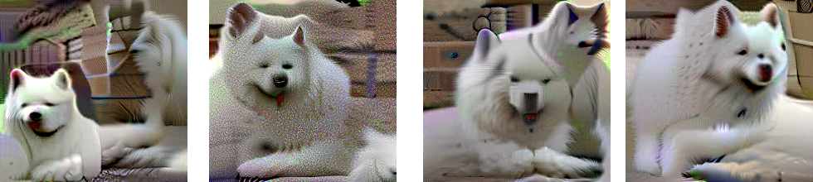
Our proposal to measure shared invariance
𝒎₁ (reference)
𝒎₂
𝙓
same
same?
𝙏(𝙓)
Find Identically Represented Inputs (IRIs) 𝙓, 𝙓’ such that 𝒎₁(𝙓) ≅ 𝒎₁(𝙓’)
𝒙
𝒙’
𝒙’
Representation Inversion (Mahendran & Vedaldi, CVPR 2015)
𝒎₁
argmin_{𝙓’} ℒ(𝒙’)
ℒ(𝒙’) = || 𝒎₁(𝒙) - 𝒎₁(𝒙’) ||₂
𝒙’ = 𝒙’ – 𝛼 ∇_{𝒙’} ℒ
𝙓
𝒎₁(𝙓) ≅ 𝒎₁(𝙓’)
𝙓’

Slide 8
Our proposal to measure shared invariance
𝒎₁ (reference)
𝒎₂
𝙓
same
same?
𝙏(𝙓)
Find Identically Represented Inputs (IRIs) 𝙓, 𝙓’ such that 𝒎₁(𝙓) ≅ 𝒎₁(𝙓’)
2. Measure similarity of 𝒎₂(𝙓) and 𝒎₂(𝙓’)
Representation Similarity Measures S_{rep}!
𝒎₁
𝙓
𝒎₁(𝙓) ≅ 𝒎₁(𝙓’)
S_{inv}(𝒎₂ | 𝒎₁, 𝙓, S_{rep}) = S_{rep} (𝒎₂(𝙓), 𝒎₂(𝙓’))
𝙓’

Slide 9

Our proposal to measure shared invariance
Find Identically Represented Inputs (IRIs) 𝙓, 𝙓’ such that 𝒎₁(𝙓) ≅ 𝒎₁(𝙓’)
2. Measure similarity of 𝒎₂(𝙓) and 𝒎₂(𝙓’)
𝒎₁
𝒎₂
𝙓
𝙓
𝒎₁(𝙓) ≅ 𝒎₁(𝙓’)
S_{rep} (𝒎₂(𝙓), 𝒎₂(𝙓’))
𝙓’
𝙓’
Similarity Through Inverted Representations
S_{inv}(𝒎₂ | 𝒎₁, 𝙓, S_{rep}) = STIR(𝒎₂ | 𝒎₁, 𝙓) = LinearCKA (𝒎₂(𝙓), 𝒎₂(𝙓’))
(Kornblith et al., 2019)
STIR explicitly captures invariances via IRIs
STIR explores regions outside 𝙓
STIR is directional

Slide 10
STIR offers insights beyond representation similarity
2 ResNet18 trained on CIFAR10 using same hyperparams – only differ in initial weights
ResNet18 Vanilla (𝒎₁),
ResNet18 Vanilla (𝒎₂)
ResNet18 Adversarial Training (𝒎₁),
ResNet18 Adversarial Training (𝒎₂)
 | 𝒎₁| 𝒎₂ | 𝒎₂| 𝒎₁
STIR | 0.605 _{± 0.013} | 0.562 _{± 0.023}
CKA | 0.967 _{± 0.000}
 | 𝒎₁| 𝒎₂ | 𝒎₂| 𝒎₁
STIR | 0.934 _{± 0.003} | 0.939 _{± 0.002}
CKA | 0.937 _{± 0.000}
Models trained using Vanilla loss only have moderate levels of shared invariance
Models trained with Adversarial Training (AT) have high levels of shared invariance
Models trained with AT should have higher shared invariance than Vanilla since AT induces invariance to ℓ_{p} perturbations
CKA is high in both cases and hence does not offer such insights
Notes:
Say final layer here

Slide 11
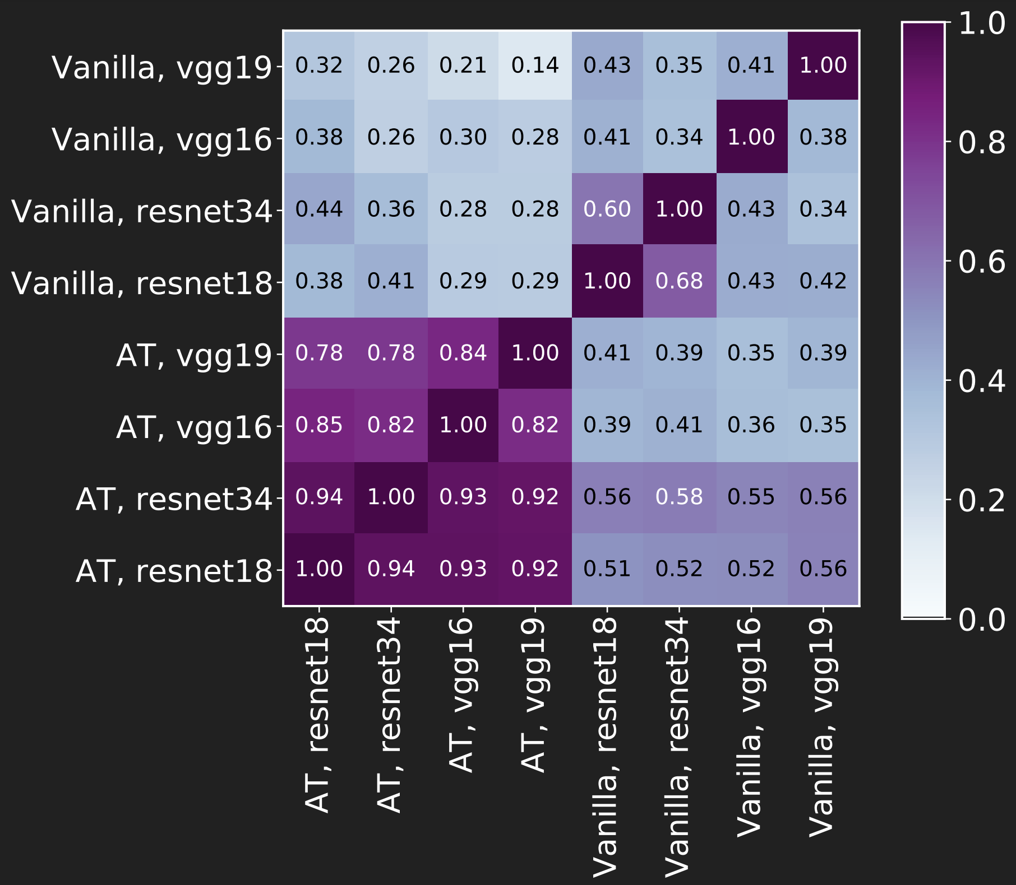
How do losses & network architectures impact STIR?
Penultimate Layer
Loss: Adversarial training leads to higher STIR scores – even for other architectures
𝒎₁ (reference)
Architectures: Higher STIR when residual networks are reference models for both Vanilla and AT!
Potential reason: initial layers have high shared invariances and residual connections preserve these features
𝒎₂
Darker = higher STIR

Slide 12
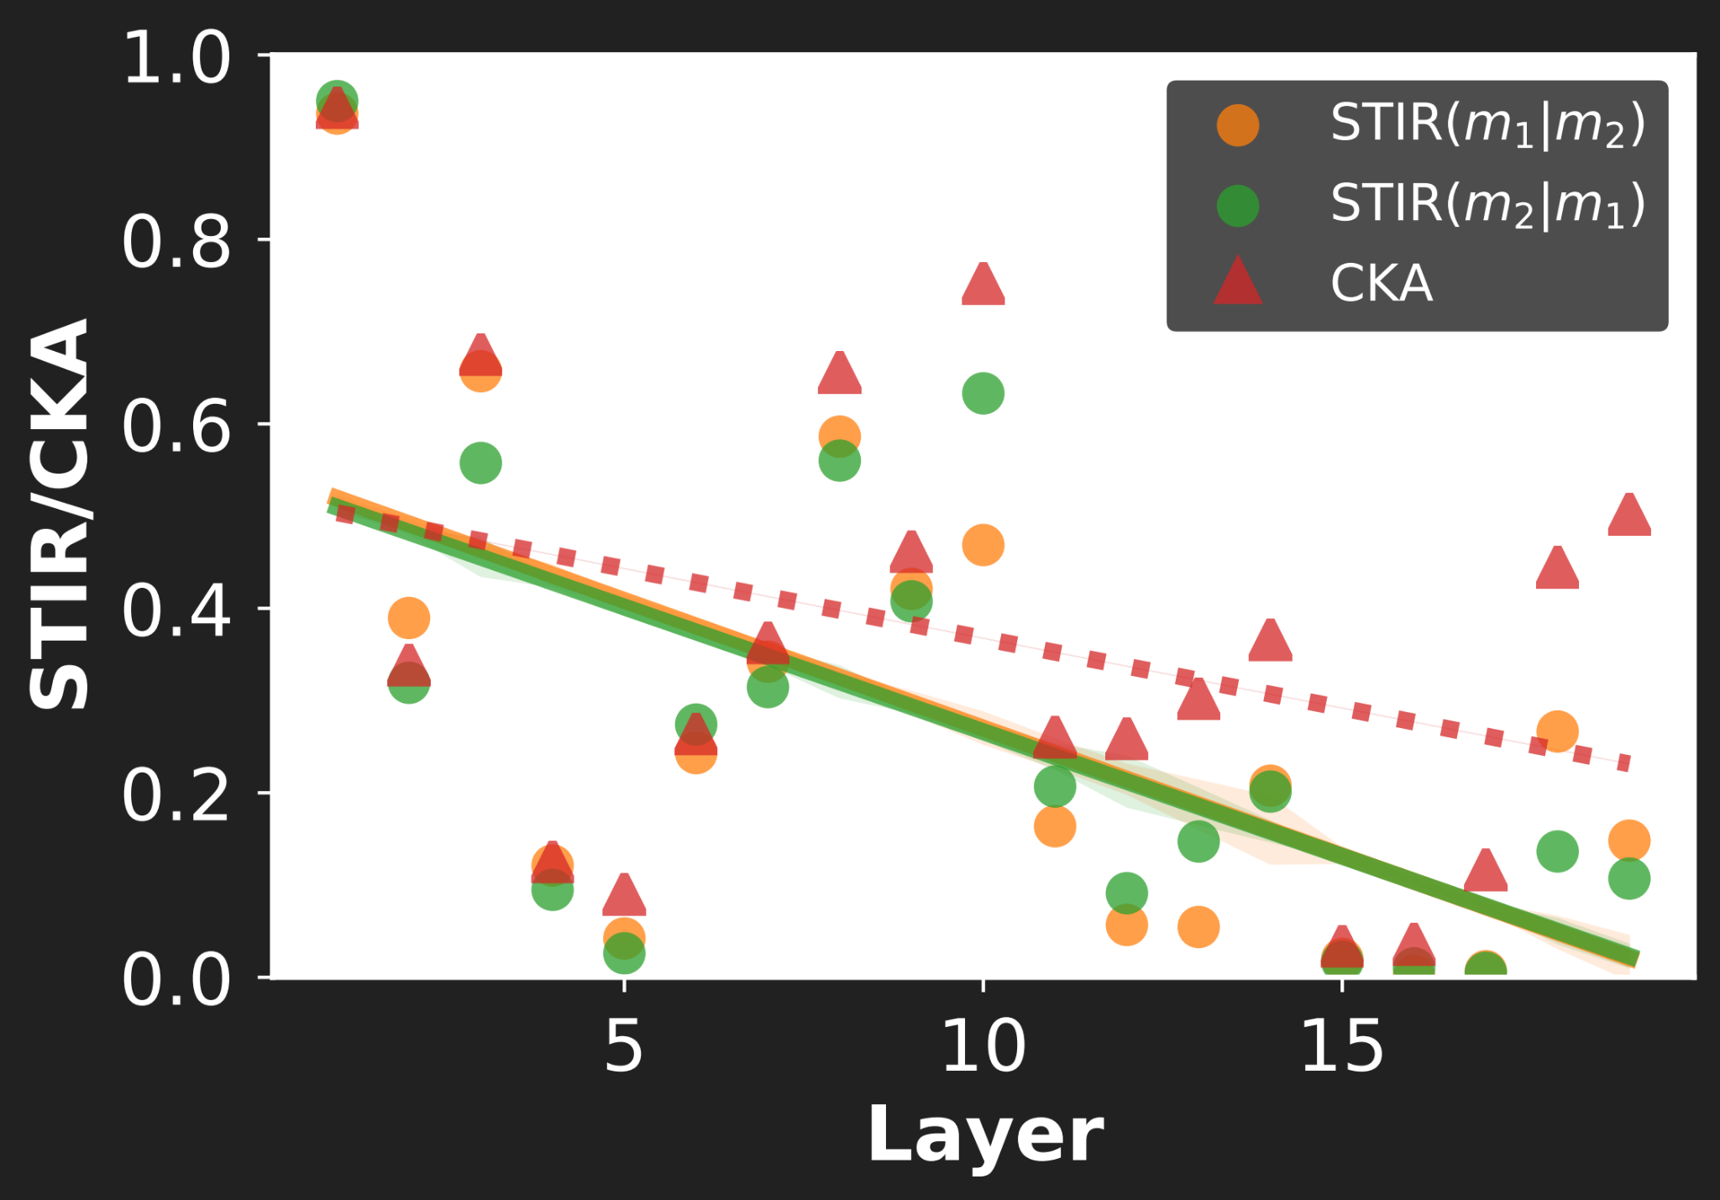
How do training datasets impact STIR?
𝒎₁ = ResNet18 on CIFAR10, 𝒎₂ = ResNet18 on CIFAR100
Also investigated by prior representation similarity works (Kornblith et al, 2019)
Final layers learn dataset specific features and hence have almost zero STIR
Higher similarity / shared invariance →
We find similar trend as CKA, however drop-off for STIR is higher in later layers
Deeper →

Slide 13
Additional questions investigated
Different initializations’ impact on STIR
AT consistently has higher STIR scores than Vanilla
Different adversarially robust losses’ impact on STIR
Only moderate STIR despite similar ℓ_{p} robustness!
How does more training data impact STIR
STIR monotonically increases as we add more data, but with diminishing returns
Check out the paper for details!
tinyurl.com/stir-paper

Slide 14
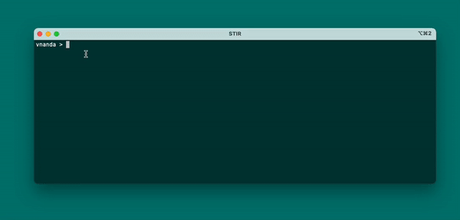

Summary
Proposed Similarity Through Inverted Representations (STIR) to study relative invariances
Explicitly captures invariances via Identically Represented Inputs
Used STIR to investigate the impact of choices in a DL pipeline
AT consistently leads to higher STIR than Vanilla; residual connections increase STIR
Paper:
tinyurl.com/stir-paper
Code:
github.com/nvedant07/stir
Thank You!
vedant@cs.umd.edu

Slide 15
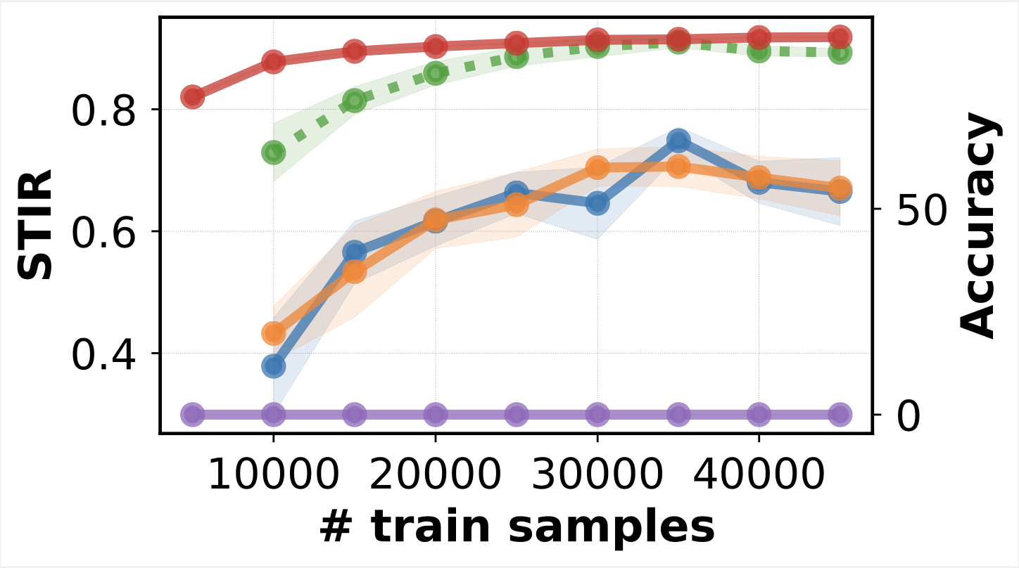
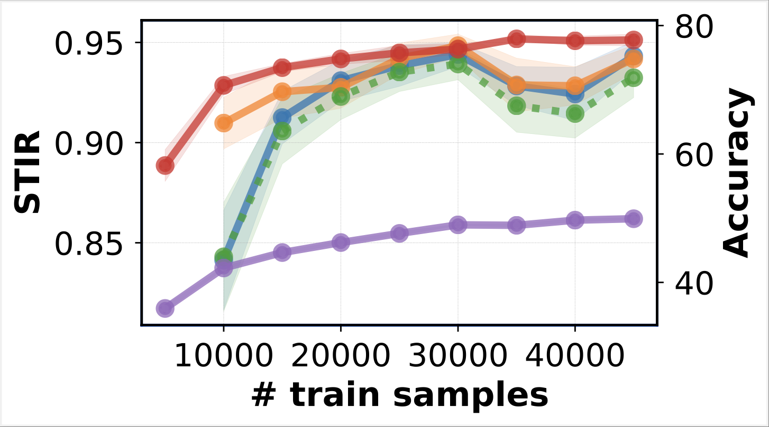
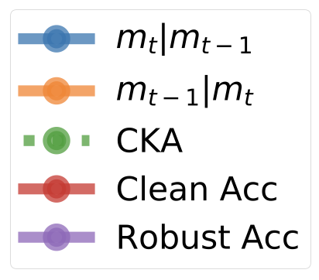
How Do Model Updates Change Shared Invariances? (backup)
Vanilla
Adversarial Training
STIR monotonically increases as we add more data, however, after a certain point, we see diminishing returns

